Slide 1

Programming Principles
1811ICT/2807ICT/7001ICT
Week 8 Lecture
Dr Mardé Helbig

Slide 2
important information
Quiz2 and exam

Slide 3

Quiz2 information
Quiz 2 will take place in Week 10
We will make an announcement towards the end of this week/early next week with more information
Early next week we will release a Sample Quiz to show what type of questions to expect

Slide 4
exam information
Closed book, online and Proctored
No dictionaries or calculators allowed
No access to software allowed
Copy/paste not allowed
Only single monitor allowed
One A4 sheet of hand-written notes on both sides of sheet
Two blank A4 sheets of paper allowed for taking notes
Bathroom breaks allowed
10 minutes to read the exam questions
2 hours to complete the exam
Exam timetable will be available on Friday 20 September

Slide 5

exam tips
Prepare for the exam and think what you want to put on your A4 sheet of hand-written notes
When you read the exam questions, start thinking how you want to spend your time:
1st do the questions you know and feel confident about – will settle your nerves and you spend time to get marks!
Then move to the questions you know somewhat
Lastly the ones you are really unsure
You have 120 minutes – calculate roughly how much time you should spend per mark and check your time as you complete the questions in the order mentioned above
Your goal is to ensure you spend your time on what you know and on enough marks to achieve your goal!
Practice these strategies with Quiz2!

Slide 6


exam tips
Marking will take into account that it is closed book
Week 12 is for review of the work
Be sure to attend that live lecture and to have your questions ready
We will make a survey available to give everyone an opportunity to submit questions that they would like to be answered in that lecture
In Week 12 I will make a few slots available during the week for check-in times where anyone can attend and ask questions about the work

Slide 7

Any questions?
Type your question in the Q&A or raise your hand

Slide 8







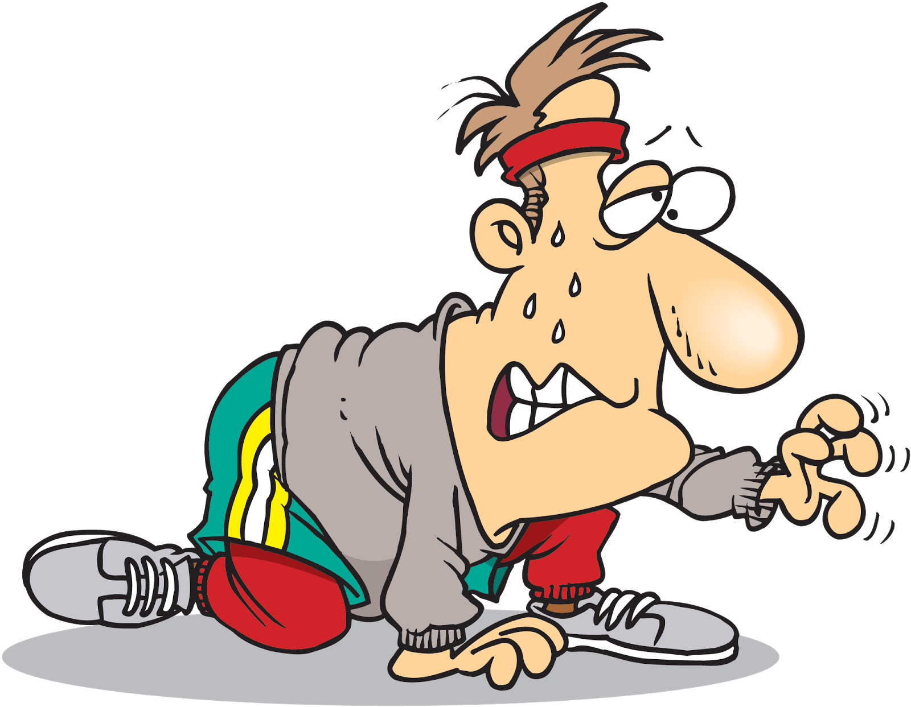




Temperature Check
How do you feel about the upcoming exam?

Slide 9
complex data structures
Section 18: debugging

Slide 10





debugging
Why is debugging important?
You want to eliminate errors from your code
Don’t want to frustrate others that use your code ...
Beginners are prone to more errors as you learn
But even experienced programmers make mistakes!

Slide 11

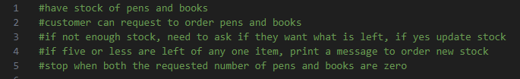
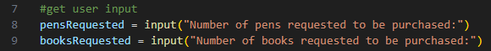
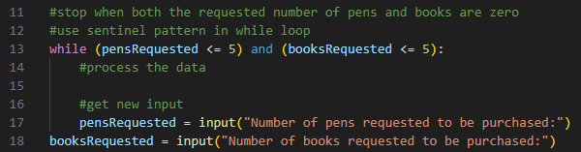
debugging with output
Step 1: Ask user for input
Step 2: When do we stop asking input? Which loop? Which pattern?

Slide 12
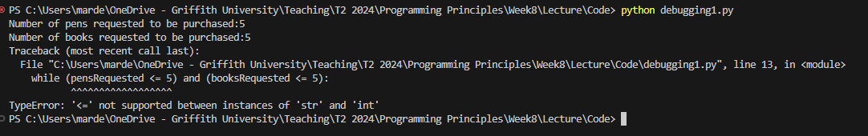





debugging with output
Step 3: Let’s test our code so far by running the script
What is wrong here? What does the message say?
How can we fix it?

Slide 13
debugging with output
Step 1: Ask user for input

Slide 14

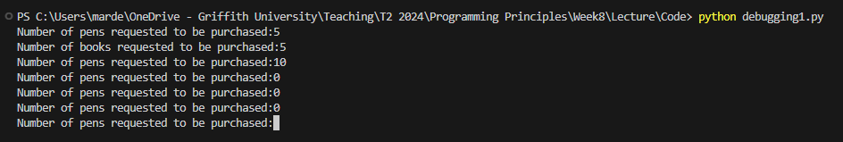
debugging with output
Step 3: Let’s test our code again by running the script
What is wrong here? It is only asking for pens! Why?
How can we fix it?

Slide 15
debugging with output
Step 1: Ask user for input
Step 2: When do we stop asking input? Which loop? Which pattern?

Slide 16
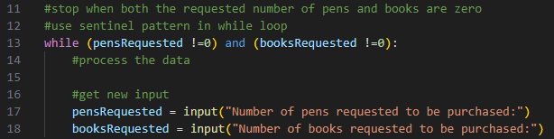






debugging with output
Step 1: Ask user for input
Step 2: When do we stop asking input? Which loop? Which pattern?

Slide 17
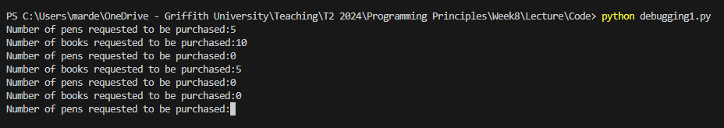






debugging with output
Step 3: Let’s test our code again by running the script
What is wrong here? It is not stopping! Why?
How can we fix it?

Slide 18
debugging with output
Step 1: Ask user for input
Step 2: When do we stop asking input? Which loop? Which pattern?

Slide 19
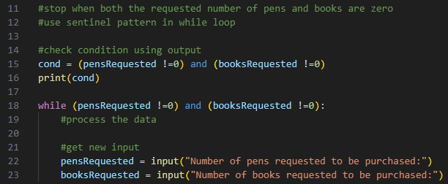



debugging with output
Step 1: Ask user for input
Step 2: When do we stop asking input? Which loop? Which pattern?

Slide 20
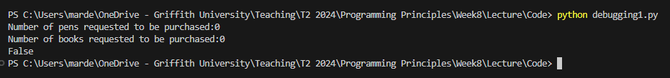

debugging with output
Step 3: Let’s test our code again by running the script
What is wrong here? Our stopping condition is false – while never executes!
How can we fix it?

Slide 21
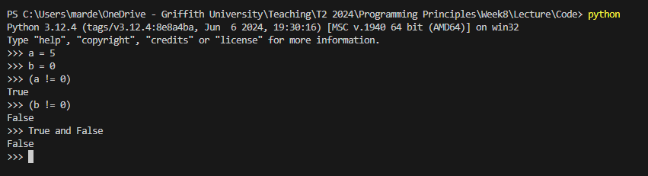


debugging with output
Step 4: Let’s check in our REPL what is going on...
What is wrong here? Our stopping condition is false – while never executes!
How can we fix it to be True and not False?

Slide 22
debugging with output
Step 1: Ask user for input
Step 2: When do we stop asking input? Which loop? Which pattern?

Slide 23
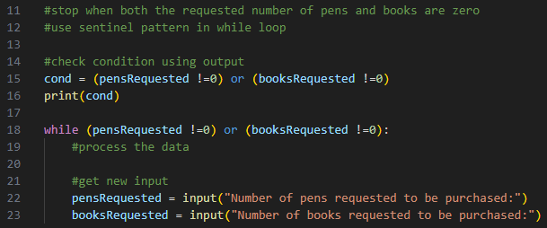



debugging with output
Step 1: Ask user for input
Step 2: When do we stop asking input? Which loop? Which pattern?

Slide 24
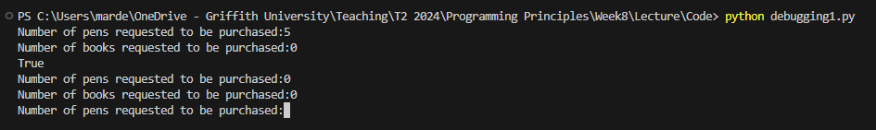






debugging with output
Step 3: Let’s test our code again by running the script
What is wrong here? While still didn’t stop! Why?
How can we fix it?

Slide 25
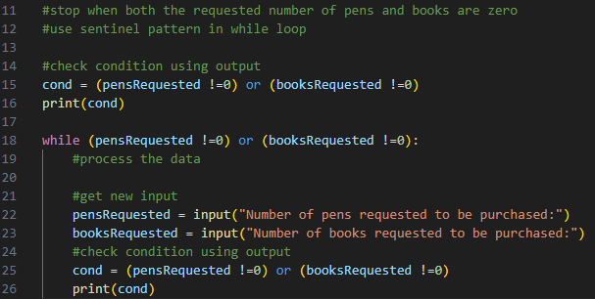
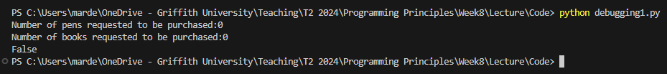
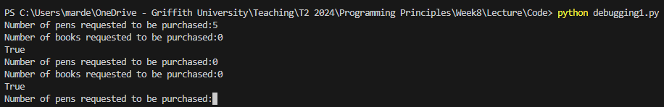









debugging with output
Step 4: Let’s check with output what is going on...
What is wrong here? 2nd time is wrong, 1st time is right... Why?
How can we fix it?

Slide 26
debugging with output
Step 1: Ask user for input
Step 2: When do we stop asking input? Which loop? Which pattern?

Slide 27
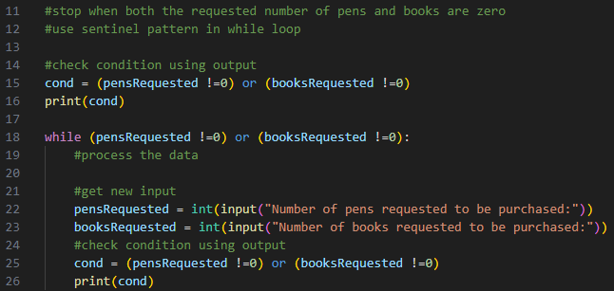




debugging with output
Step 1: Ask user for input
Step 2: When do we stop asking input? Which loop? Which pattern?

Slide 28
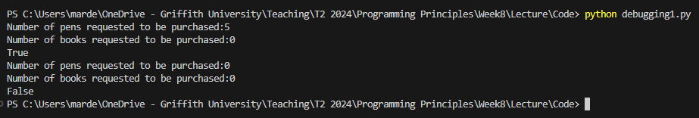



debugging with output
Step 3: Let’s test our code again by running the script

Slide 29
Any questions?
Type your question in the Q&A or raise your hand

Slide 30
Temperature Check
How do you feel about debugging using output?

Slide 31

debugging with IDE
Demo same problem using IDE
Watch PyCharm Example (Section 19)
YouTube tutorial debugging with Visual Code

Slide 32
Any questions?
Type your question in the Q&A or raise your hand

Slide 33
Temperature Check
How do you feel about debugging using an IDE?

Slide 34

5 Minute Break Time!
Start again at 12:05

Slide 35

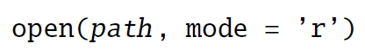
closing files
myFile =
returns a file handle
referenced by myFile
myFile is operated on by methods of the file object
It is your responsibility to close the file object when you are done with the close method:
myFile.close()

Slide 36
complex data structures
Sections 19 and 20: errors and exceptions, and files

Slide 37
file handles
In Python:
All information about a file that you work on in a program is stored in an object
A variable that refers to (references) one of these objects is called a file handle
You need a file handle to access a file like a key gives you access to your house or the treasure in a chest

Slide 38
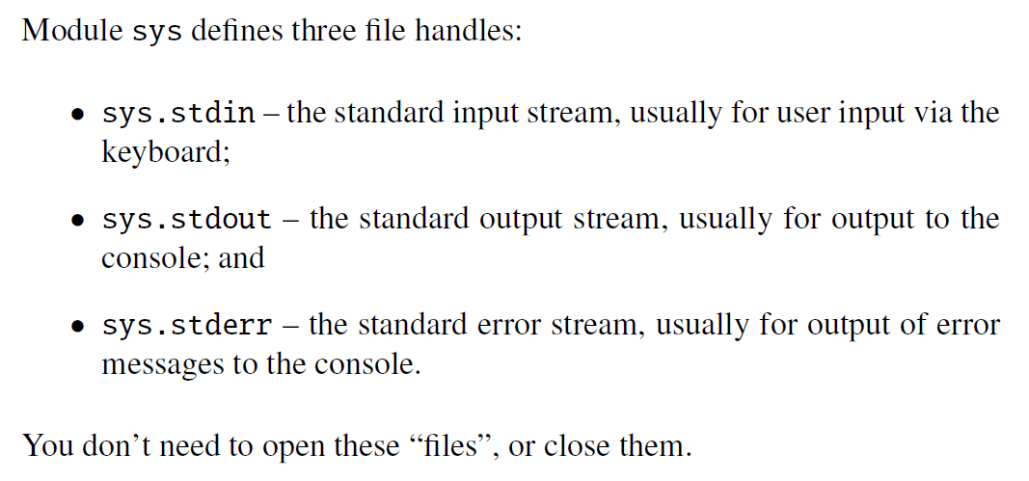
Pre-defined file handles

Slide 39
opening files
built-in function to open a file
default mode is reading
returns a file handle
what can be done with the file
location and name of file
Modes used most often:
Mode | Meaning
‘r’ | read text from file
‘w’ | write to a file; if file does not exist it gets created, if file exists it gets overwritten (all other data in file deleted)
‘a’ | append to a file; if file does not exist it gets created, if file exists write to end of file (all other data in file remains untouched)

Slide 40
reading and writing
line = myFile.readline()
readline reads one line from myFile
readline returns empty string if end of myFile has been reached
myFile.write(line)
write writes line to myFile
How do you think we can read various lines from a file or write multiple lines to a file?
Loops!

Slide 41
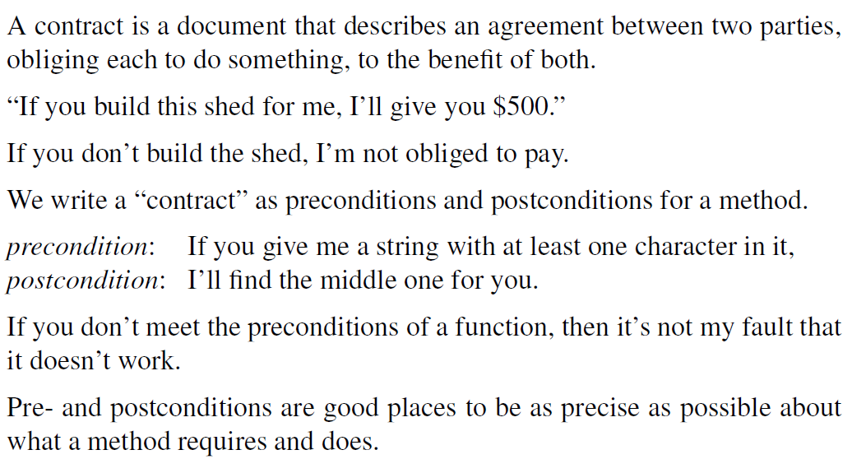
managing errors: programming by contract

Slide 42
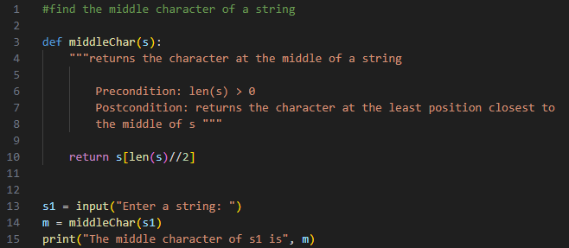
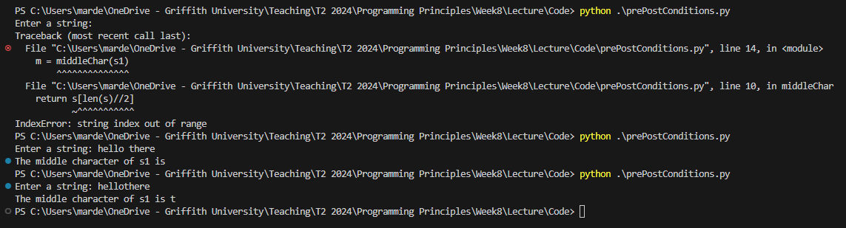
managing errors: programming by contract

Slide 43
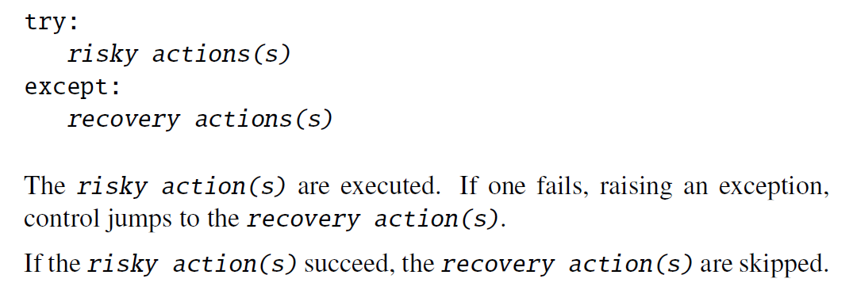
managing errors: try-except

Slide 44
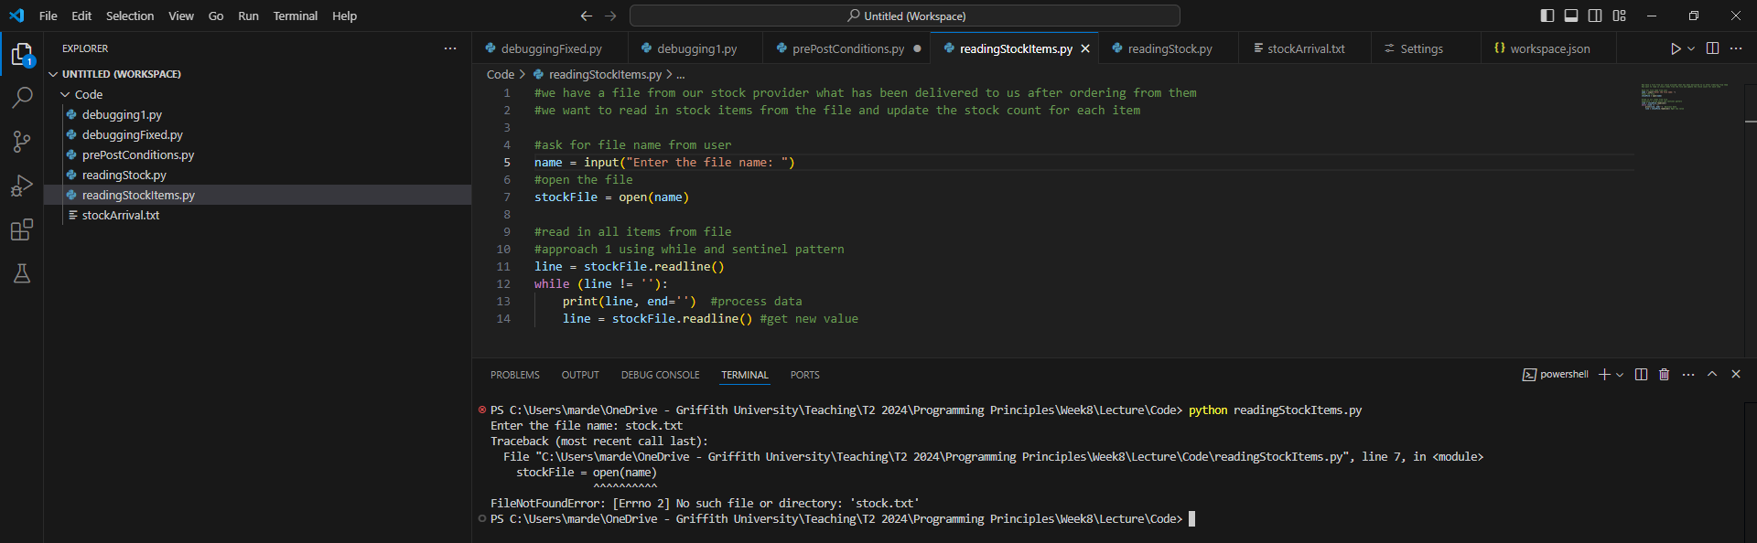
managing errors: try-except
How can we deal with “FileNotFoundError”, i.e. when the file does not exist?

Slide 45
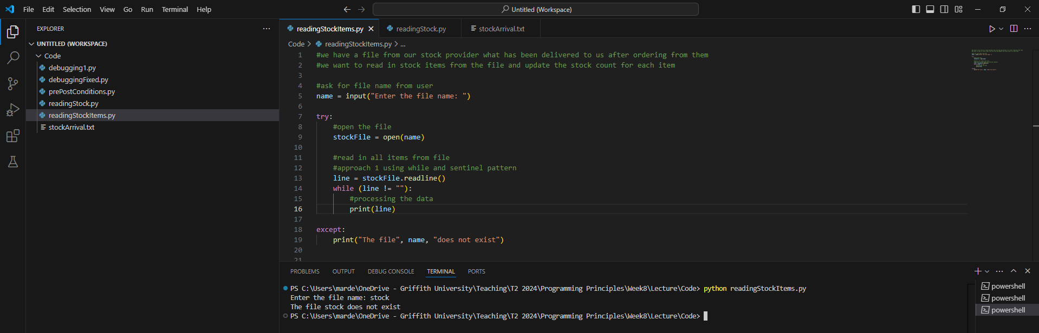




managing errors: try-except

Slide 46
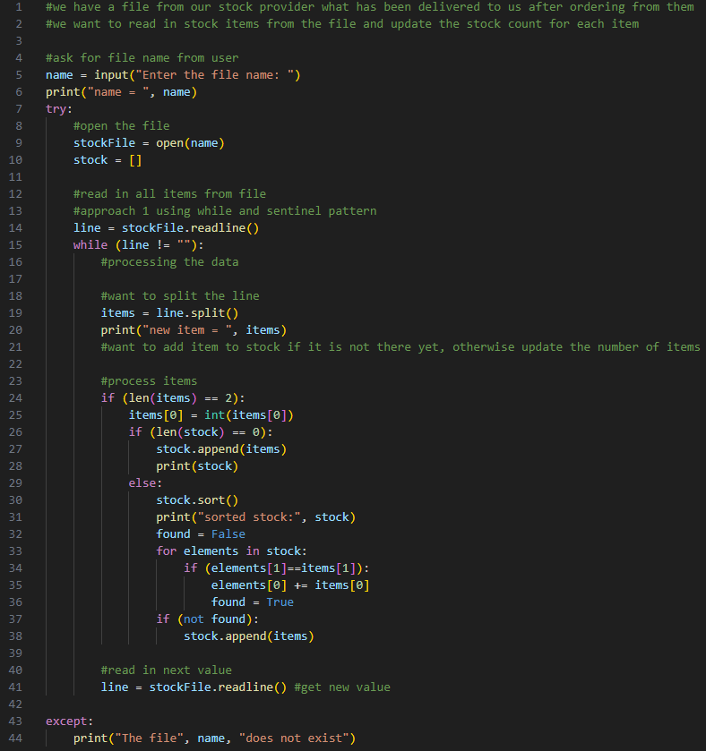
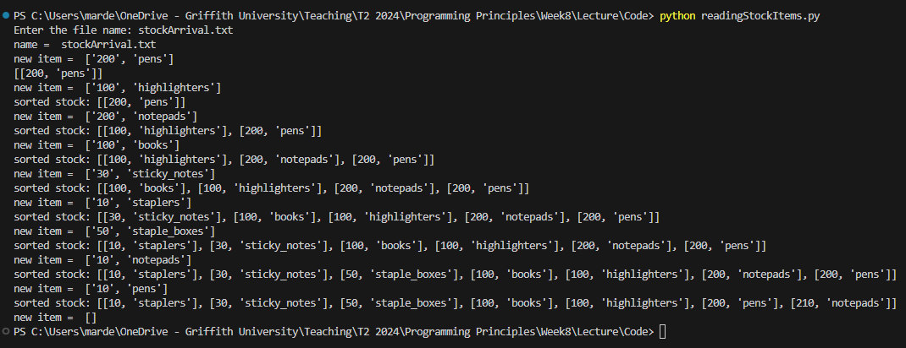
processing file data

Slide 47
Any questions?
Type your question in the Q&A or raise your hand

Slide 48
Temperature Check
How do you feel about files?

